Slide 1





Music Genre Classification
By: Ashraf Abdulkhaliq | Hamza Al-Habash | Ammar Abushukur

Slide 2
DATASET DESCREPTION
OUR DISCUSSION POINTS
artist: Name of the Artist.
song: Name of the Track.
popularity: The higher the value the more popular the song is.
danceability: Danceability describes how suitable a track is for dancing based on a combination of musical elements including tempo, rhythm
energy: Energy is a measure from 0.0 to 1.0 and represents a perceptual measure of intensity and activity.
key: The key the track is in. Integers map to pitches using standard Pitch Class notation.
loudness: The overall loudness of a track in decibels (dB). Loudness values are averaged across the entire track and are useful for comparing relative
mode: Mode indicates the modality (major or minor) of a track, the type of scale from which its melodic content is derived. Major is represented by 1 and minor is 0.

Slide 3
DATASET DESCREPTION
OUR DISCUSSION POINTS
speechiness: Speechiness detects the presence of spoken words in a track. The more exclusively speech-like the recording (e.g. talk show, audio book, poetry), the closer to 1.0 the attribute value.
acousticness: A confidence measure from 0.0 to 1.0 of whether the track is acoustic. 1.0 represents high confidence the track is acoustic.
instrumentalness: Predicts whether a track contains no vocals. "Ooh" and "aah" sounds are treated as instrumental in this context. Rap or spoken word tracks are clearly "vocal". The closer the instrumentalness value is to 1.0, the greater likelihood the track contains no vocal content. Values above 0.5 are intended to represent instrumental tracks, but confidence is higher as the value approaches 1.0.

Slide 4
DATASET DESCREPTION
OUR DISCUSSION POINTS
liveness: Detects the presence of an audience in the recording. Higher liveness values represent an increased probability that the track was performed live. A value above 0.8 provides strong likelihood that the track is live.
valence: A measure from 0.0 to 1.0 describing the musical positiveness conveyed by a track. Tracks with high valence sound more positive (e.g. happy, cheerful, euphoric), while tracks with low valence sound more negative (e.g. sad, depressed, angry).
tempo: The overall estimated tempo of a track in beats per minute (BPM). In musical terminology, tempo is the speed or pace of a given piece and derives directly from the average beat duration.
duration in milliseconds :Time of the song
time_signature : a notational convention used in Western musical notation to specify how many beats (pulses) are contained in each measure (bar), and which note value is equivalent to a beat.
Class: Genre of the track.

Slide 5
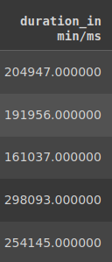
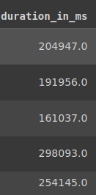
DATA CLEANING
Sorting out The unit
The duration in ms/min column had values in either ms or min units, we changed all the values to be in ms using 5000 as threshold

Slide 6
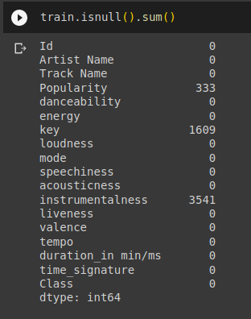
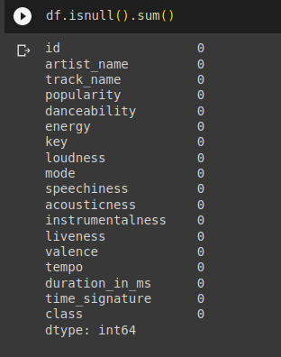
Data Cleaning
Null Values
Simple Imputer

Slide 7
Data Cleaning
Scaling
Considering our dataset contains features that have different units, we used standard scaler to standarize the units

Slide 8
Data Visualizations (Plots)

Slide 9
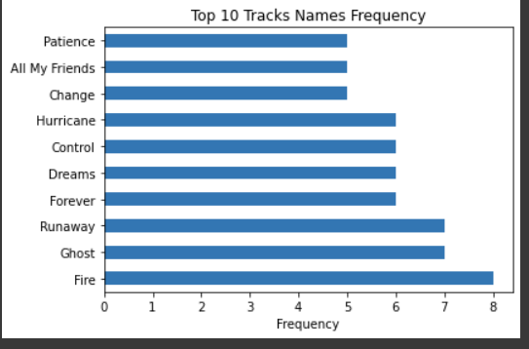
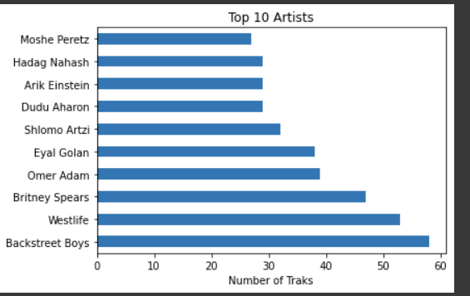
What are the top 10 most frequent track names in the dataset?
Which artist has the highest number of tracks published?

Slide 10
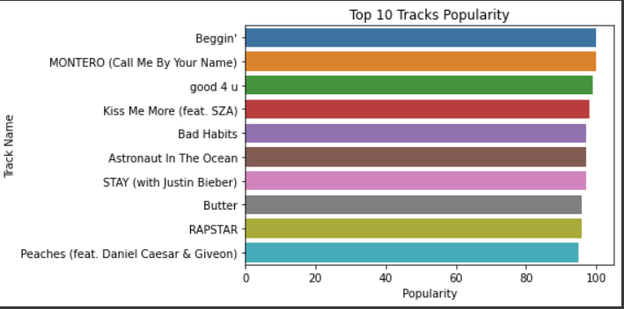
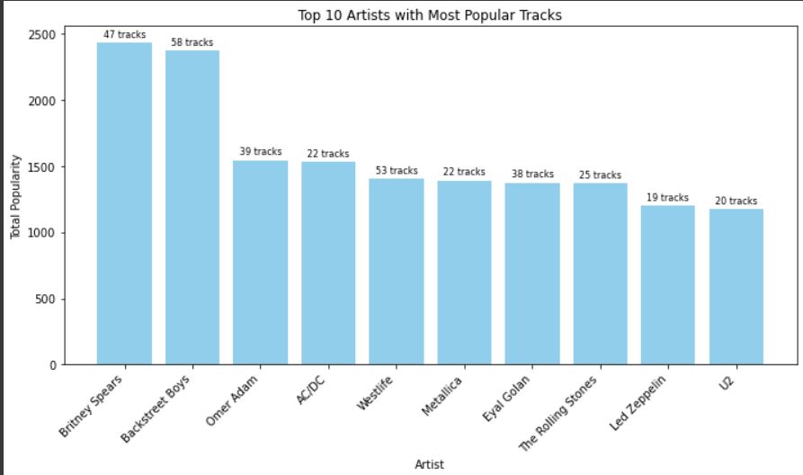
Which track holds the highest position as the most popular among the top 10?
How is the popularity of tracks determined for each artist in the dataset?

Slide 11
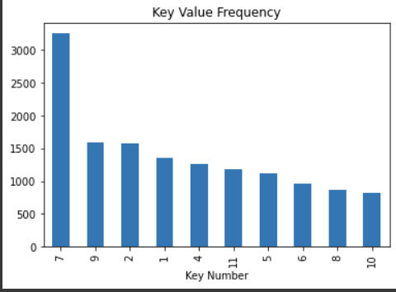
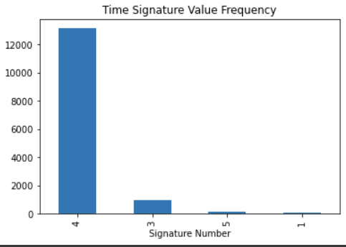
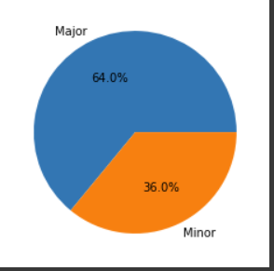
The major is dominating for all columns
Major represented by 1
Minor represented by 0

Slide 12
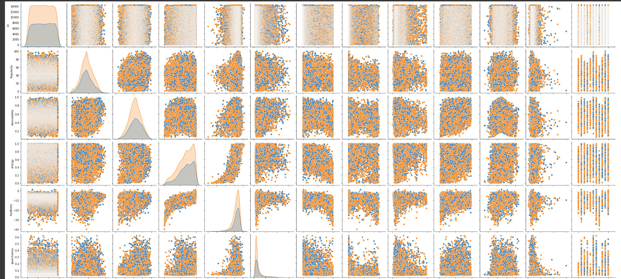
Major represented by 1 [orange]
Minor represented by 0 [blue]

Slide 13
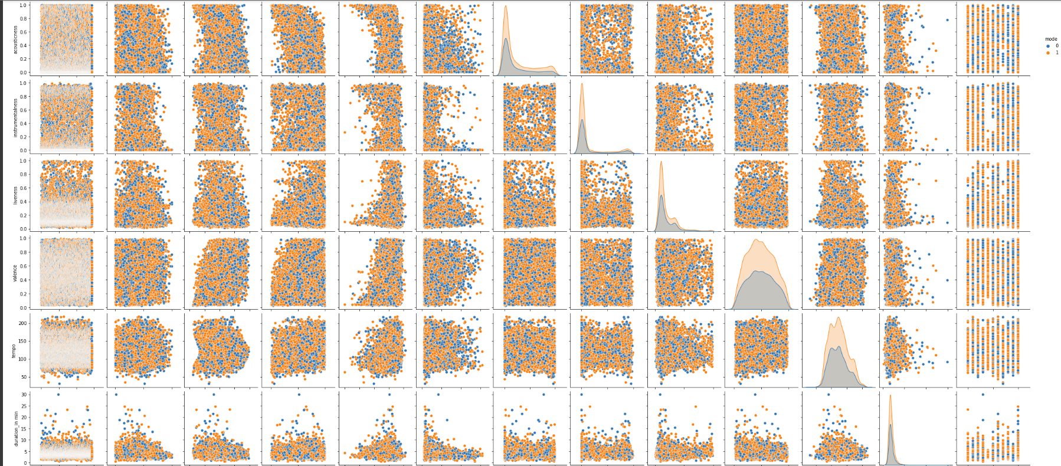

Slide 14
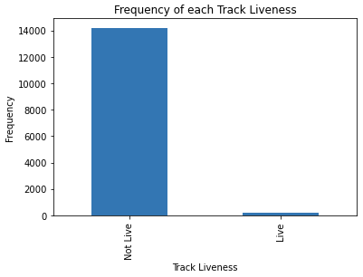
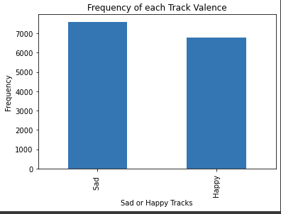
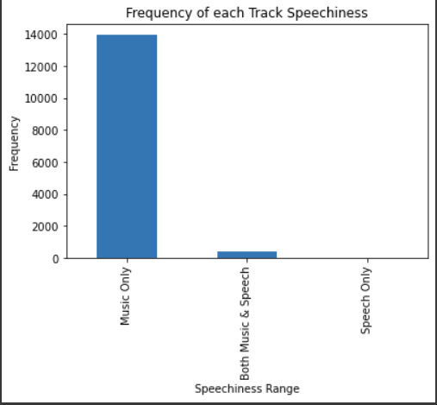
We can understand from this bar plot that our data have 13953 tracks that only music, 430 tracks that music & speech and only 13 track speech.
We can understand from this bar plot that our data have 7614 tracks that have sad/depression tone, but in the other hand we have 6782 tracks that have happy/cheerful tone.
We can understand from this bar plot that our data have only 195 tracks was live from total 14396 tracks.

Slide 15
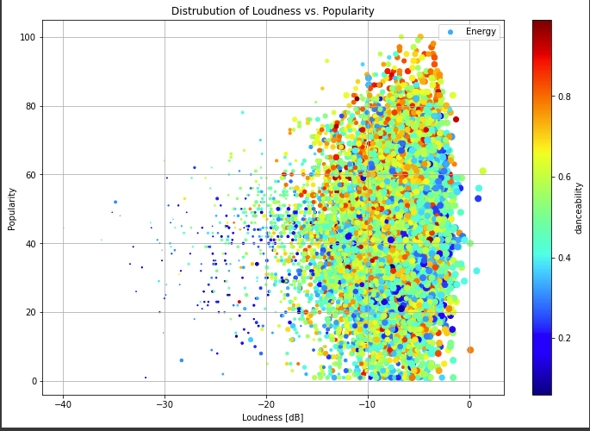
Is there a relationship between the loudness of a song and its popularity, and does this relationship differ based on the intensity of danceability and energy levels of the songs?

Slide 16
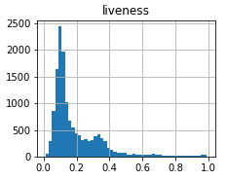
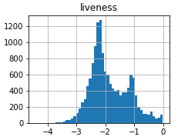
Data Transformation
Making data normally distributed(Liveliness)
LOG

Slide 17
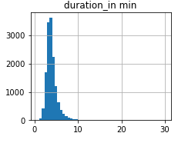
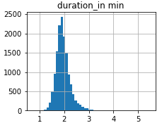
Data Transformation
Making data normally distributed (Duration in ms)
SQRT

Slide 18
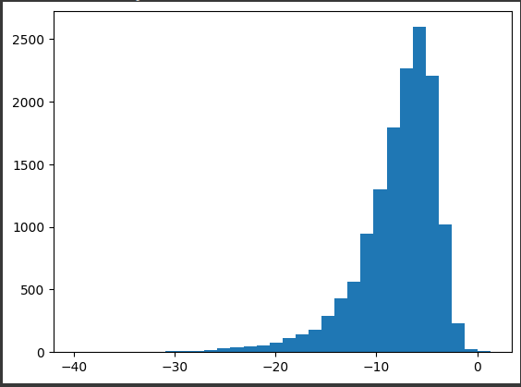
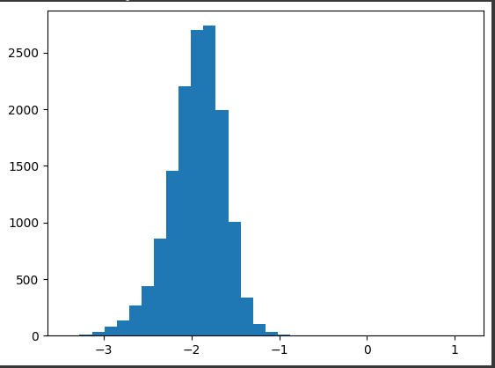
Data Transformation
Making data normally distributed (Loudness) with scaling
CBRT

Slide 19
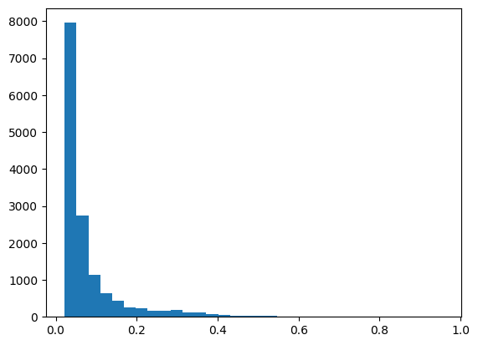
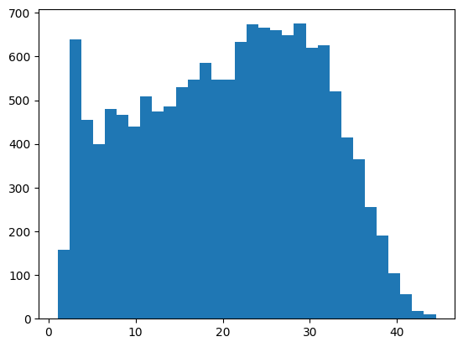
Data Transformation
Making data normally distributed(Speechiness)
Reciprocal

Slide 20
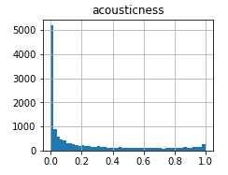
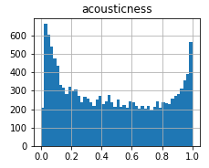
Data Transformation
Making data normally distributed(Acousticness)
CBRT

Slide 21
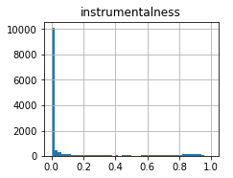
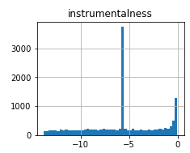
Data Transformation
Making data normally distributed(Instrumentalness)
LOG

Slide 22
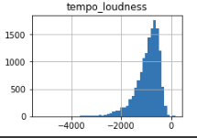
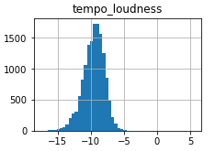
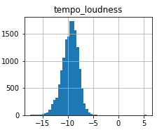
Feature engineering
Our model underfit at first, so we decided to make a new polynomial feature consisting of tempo times loudness which gave better results
CBRT

Slide 23
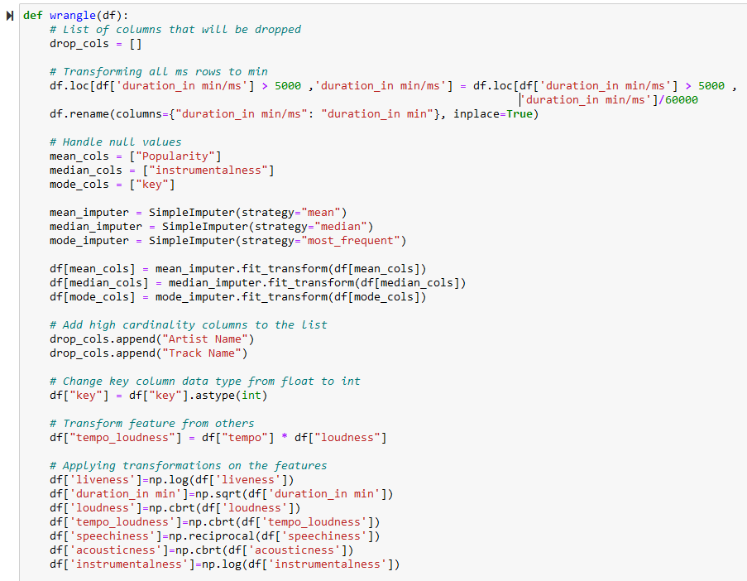
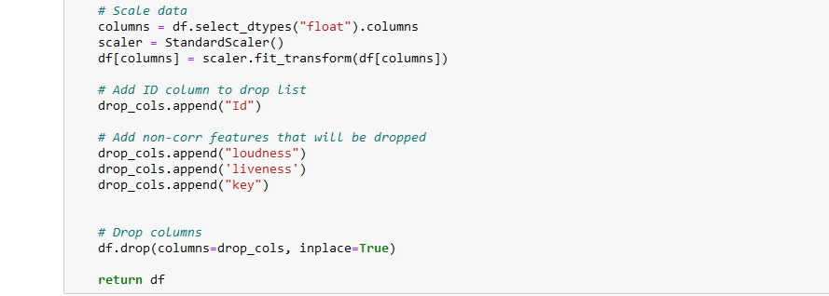
Wrangle function
Stratifying
To clean and prepare our data in one step

Slide 24
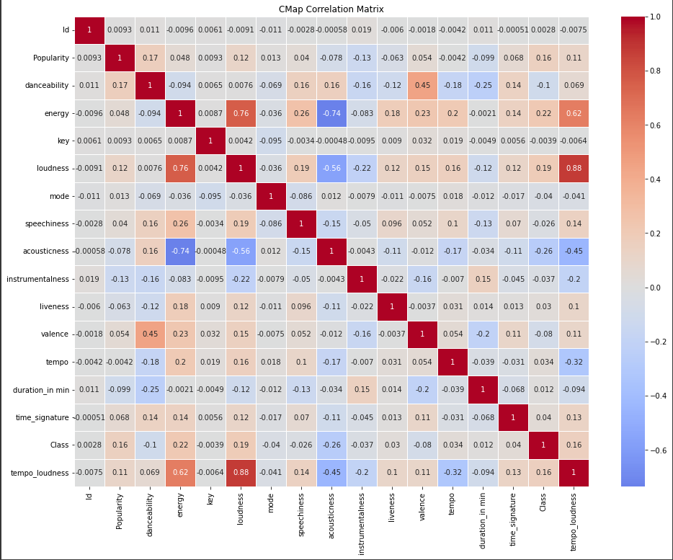
The correlation between features ranges from -1 to 1, where negative values indicate negative correlation, positive values imply positive correlation, and 0 represents no correlation. Higher values indicate stronger correlations, regardless of their direction (positive or negative). The redness of the box is correlated with the values.
What correlations can we conclude from this? Which features are strongly each others?

Slide 25
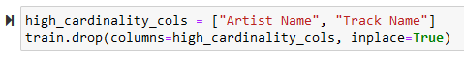
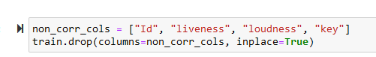
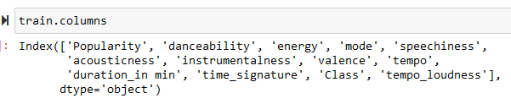
The Model
Features selection

Slide 26
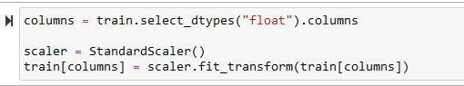
The Model
Features scaling using Standard Scaler

Slide 27
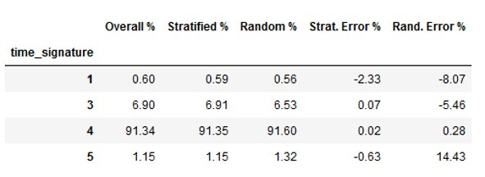
Train/test split
Stratifying
An unbiased evaluation is crucial to avoid introducing temporal leakage and to ensure the model's generalization to future data. The traditional random train-test split can lead to biased results, undermining the model's performance assessment. To address this, a "stratified split" based on the time signature column.

Slide 28
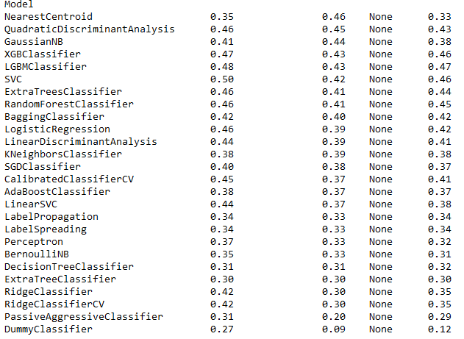
Model Selection
Lazy predict
Lazy Predict help build a lot of basic models without much code and helps understand which models works better without any parameter tuning

Slide 29
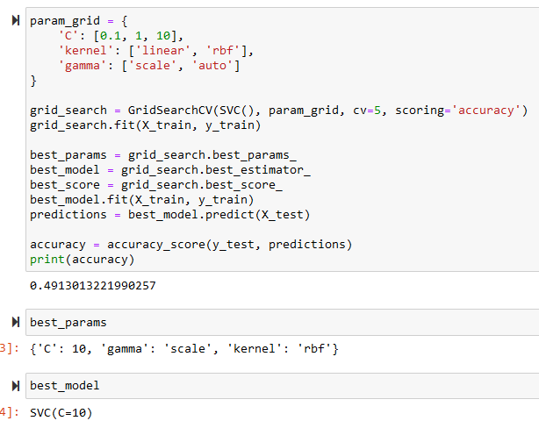
Model Selection
GridSearchCV

Slide 30
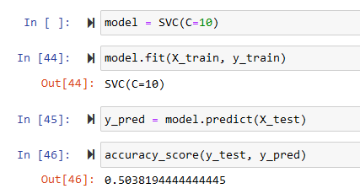
Model Selection
Support Vector Machine

Slide 31
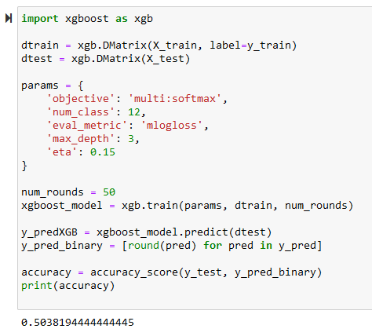
Ensemble Methods
XGBOOST

Slide 32

PRODUCT FEATURES
SLEEK AESTHETICS
Presentations are communication tools that can be demonstrations, lectures, and more.
USABILITY
Presentations are communication tools that can be demonstrations, lectures, and more.
10-YEAR WARRANTY
Presentations are communication tools that can be demonstrations, lectures, and more.

Slide 33



WHAT SETS US APART?
WHY CHOOSE AUDIOS?
Diverse Lineup
Sound Quality
Customer Service

Slide 34



Creating Our Sound
STEP 1
STEP 2
STEP 3
Presentations are communication tools that can be demonstrations, lectures, and more.
Presentations are communication tools that can be demonstrations, lectures, and more.
Presentations are communication tools that can be demonstrations, lectures, and more.

Slide 35
8/10
STUDIOS USE AUDIOS
Presentations are communication tools that can be used as demonstrations, lectures, speeches, reports, and more. It is mostly presented before an audience. It serves a variety of purposes, making presentations powerful tools for convincing and teaching.

Slide 36
Item 5
20%
Item 1
20%
OUR PRODUCT CATALOG
SALES OF OUR POPULAR PRODUCTS
Item 4
20%
Item 2
20%
Presentations are communication tools that can be used as demonstrations, lectures, speeches, reports, and more.
Item 3
20%

Slide 37
SOFIA TABUENA
Award-Winning Artist
Presentations are communication tools that can be used as demonstrations, lectures, speeches, reports, and more.
CALEB GEORGE
What People Have to Say
Guitarist
Presentations are communication tools that can be used as demonstrations, lectures, speeches, reports, and more.
HELENA PETERS
Producer
Presentations are communication tools that can be used as demonstrations, lectures, speeches, reports, and more.

Slide 38
OTHER BRANDS
AUDIOS PROFESSIONAL X
Presentations are communication tools that can be used as demonstrations, lectures, speeches, reports, and more.
Presentations are communication tools that can be used as demonstrations, lectures, speeches, reports, and more.
AAI | Pro X

Slide 39
IN THE WORKS
TURNING OUR DREAMS INTO REALITY
Presentations are communication tools that can be used as demonstrations, lectures, speeches, reports, and more. It is mostly presented before an audience. It serves a variety of purposes, making presentations powerful tools for convincing and teaching.
If you’d like to add more content to your presentation, there are plenty of options. You can include photos of your team, descriptions of products, or your goals as a company. It all depends on the purpose of your presentation, and how you plan to arrange the details.
AAI | Pro X

Slide 40
JANUARY
To create a stunning presentation, it's best to simplaify your thoughts.
FUTURE PRODUCT RELEASES
APRIL
To create a stunning presentation, it's best to simplify your thoughts.
MAY
To create a stunning presentation, it's best to simplify your thoughts.
ESTIMATED ANNOUNCE DATES
JULY
To create a stunning presentation, it's best to simplify your thoughts.
OCTOBER
To create a stunning presentation, it's best to simplify your thoughts.
AAI | Pro X

Slide 41
The Key to Success
AMAZING CUSTOMER SERVICE AND WARRANTIES
COMPETITIVE PRICE POINTS
GREAT SOUND
QUALITY
Presentations are communication tools that can be used as demonstrations, lectures, and more.
Presentations are communication tools that can be used as demonstrations, lectures, and more.
Presentations are communication tools that can be used as demonstrations, lectures, and more.

Slide 42




HOW TO ORDER
THROUGH OUR SITE
Presentations are communication tools that can be used as demonstrations, lectures, and more.
BRICK AND MORTAR
Presentations are communication tools that can be used as demonstrations, lectures, and more.
ONLINE AFFILIATES
Presentations are communication tools that can be used as demonstrations, lectures, and more.
SELECTED APPLIANCE STORES
Presentations are communication tools that can be used as demonstrations, lectures, and more.

Slide 43
PRO X FOR THE
MODERN PRO
Presentations are communication tools that can be used as demonstrations, lectures, speeches, reports, and more.
AAI | Pro X

Slide 44




Find Us Online
FACEBOOK
To create a stunning presentation, it's best to simplify your thoughts.
TWITTER
To create a stunning presentation, it's best to simplify your thoughts.
INSTAGRAM
To create a stunning presentation, it's best to simplify your thoughts.

Slide 45



THE TEAM BEHIND AUDIOS
DEREK CAPRIS
CEO and Producer
GET TO KNOW US
DIANA WHEYMAN
Creative Director
JIMMY ALECANTA
Marketing Director
AAI | Pro X

Slide 46
CONTACT US
WE'D LOVE TO HEAR FROM YOU!
MAILING ADDRESS
123 Anywhere St., Any City, State, Country 12345
EMAIL ADDRESS
hello@reallygreatsite.com
PHONE NUMBER
(123) 456 7890

Slide 47

FINAL WORDS
Music is the movement of sound to reach the soul for the education of its virtue.
PLATO
AAI | Pro X

